Slide 1
AS91896[2.7] AS91887[2.8] Documentation
[Peter McKay]

Slide 2
[Monster_Cards_Internal]
Link to GitHub Repository:
[https://github.com/peter123321123321/Monster-Cards-Internal]
Links to Trello board / project management tools:
[https://trello.com/b/HvmDrkWJ/monstercardsinternal]
Link to final version of your program:
[https://github.com/peter123321123321/Practice-Internal/blob/main/Final_VersionV2.py]
Ensure you have made these links ‘public’ so that they are open to anyone, including the marker. The link to your program is the final outcome of this whole project – your finished program.

Slide 3
Explain relevant Implications:
Additional rows can be added by clicking in the last cell and then using the Tab key
Relevant implication | Explain the implication and say how it is relevant to this project
Usability | Usability is about making the program as easy to use as possible for the largest number of users. It considers things like are instructions clear so that the user can avoid and correct errors, and does it tell the user what is currently happening. It is important to minimize or eliminate frustration by eliminating the things that could cause frustration.
Functionality | Functionality is making sure that the outcome works as intended. It should work for expected, unexpected, and boundary cases. For example, if the user is asked to input yes or no when asked a question. Along with expected cases, e.g., yes or no it. It should also works as intended If the user inputs unexpected cases, e.g., maybe or 1234. Another part of functionality is making the code as efficient as possible. This can be done by breaking large code problems into multiple subproblems.
Notes:
Additional rows can be added by clicking in the last cell and then using the Tab key

Slide 4
Explain relevant Implications:
Additional rows can be added by clicking in the last cell and then using the Tab key
Relevant implication | Explain the implication and say how it is relevant to this project
Future proofing | As technology develops digital systems and programs will quickly become obsolete or inefficient which is why its important to future proof your project to make sure its easy to edit, change and improve in the case it needs to be. You can do this by annotating your code (writing down what each part of the program does). Splitting the program into smaller functions that can be edited easily without affecting the entire program and many others
Aesthetics | Aesthetics is the overall look of the program and making the outcome pleasing to look at/use. A program with proper spacing prompts and decoration will be more aesthetic than one without and be easier for a user to navigate. when thinking about aesthetics you should consider things like, Is it well laid out, Does it follow design conventions, does it reduce unused information. So that it has a cleaner look.
Notes:
Additional rows can be added by clicking in the last cell and then using the Tab key

Slide 5
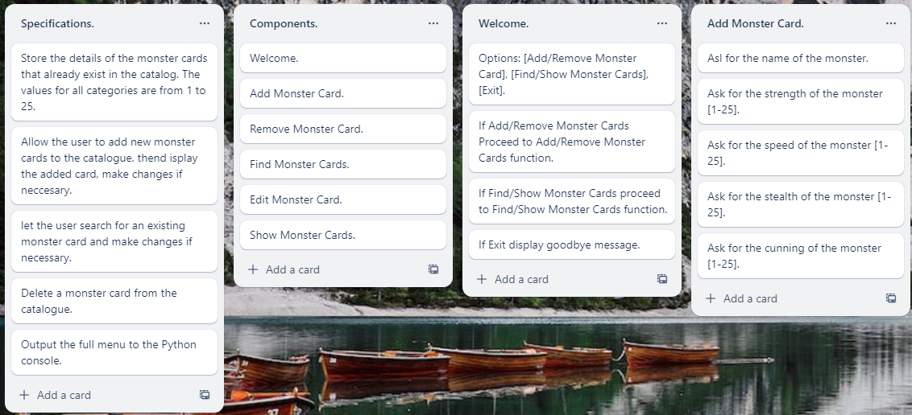
Decomposition:
Paste screenshots of your initial Trello board / task decomposition on this slide. If you have a long list, you might need to break it up into several slides.
Notes:
Paste screenshots of your initial Trello board / task decomposition on this slide. If you have a long list, you might need to break it up into several slides.

Slide 6
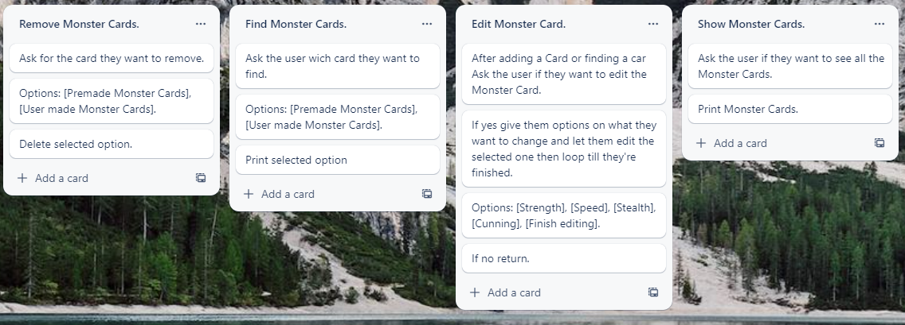
Decomposition:
Paste screenshots of your initial Trello board / task decomposition on this slide. If you have a long list, you might need to break it up into several slides.
Notes:
Paste screenshots of your initial Trello board / task decomposition on this slide. If you have a long list, you might need to break it up into several slides.

Slide 7
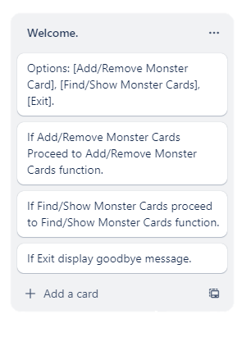
[Welcome] (Trello screenshot)

Slide 8
[Welcome] - Test Plan
Additional rows can be added by clicking in the last cell and then using the Tab key
Test Cases - input | Expected output
Add MONSTER | add_monster()
Remove MONSTER | remove_monster()
Find Show | Find_show()
Exit | Exit()
Notes:
Additional rows can be added by clicking in the last cell and then using the Tab key

Slide 9
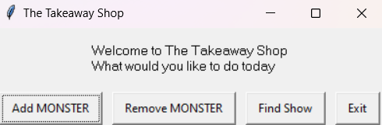
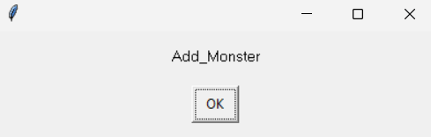
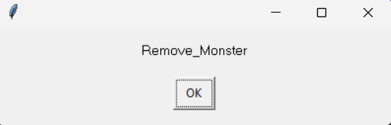
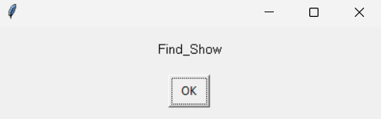
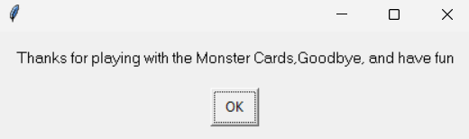
[Welcome]: Testing
You must show the results of testing. For each component, include a screenshot proving it works. You can also include notes about each test.
Placeholders just to test that it was working
Test Cases - input | Expected output
Add MONSTER | add_monster()
Remove MONSTER | remove_monster()
Find Show | Find_show()
Exit | Exit()
Notes:
You must show the results of testing. For each component, include a screenshot proving it works. You can also include notes about each test.

Slide 10
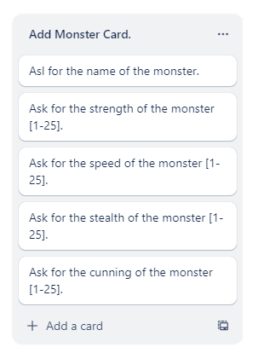
[Add Monster Cards] (Trello screenshot)

Slide 11
[Add Monster Cards] - Test Plan
Additional rows can be added by clicking in the last cell and then using the Tab key
Test Cases - input | Expected output
Enter the Monster Name 1. MONSTER1 2. Cancel | 1.Adds name to dictionary 2.Return to welcome
Monster Strength 21 2. Cancel | Adds Strength stat to dictionary
Monster Speed 1. 21 2. 1.5 | Adds Speed stat to dictionary
Monster Stealth 1. 2. | Adds Stealth stat to dictionary
Monster Cunning | Adds Cunning stat to dictionary
Notes:
Additional rows can be added by clicking in the last cell and then using the Tab key

Slide 12
[Add Monster Cards]: Testing
You must show the results of testing. For each component, include a screenshot proving it works. You can also include notes about each test.
Test Cases - input | Expected output
Add MONSTER | add_monster()
Remove MONSTER | remove_monster()
Find Show | Find_show()
Exit | Exit()
Notes:
You must show the results of testing. For each component, include a screenshot proving it works. You can also include notes about each test.

Slide 13
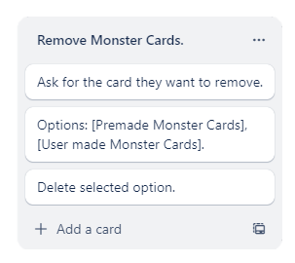
[Remove Monster Cards] (Trello screenshot)

Slide 14
[Remove Monster Cards] - Test Plan
Additional rows can be added by clicking in the last cell and then using the Tab key
Test Cases - input | Expected output
What Monster Card would you like to Delete | Show Options
Premade cards | Delete selected Card
User made cards | Delete selected Card
Return | Return to welcome function
Notes:
Additional rows can be added by clicking in the last cell and then using the Tab key

Slide 15
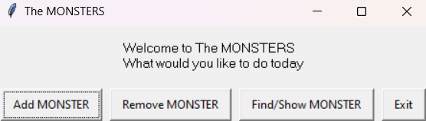
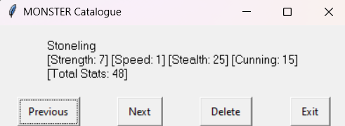
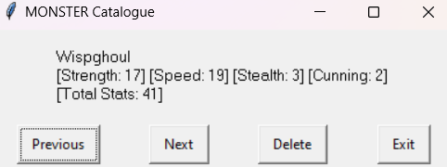
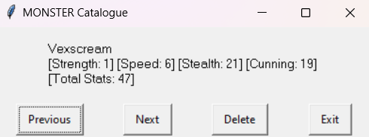
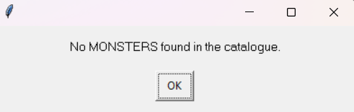
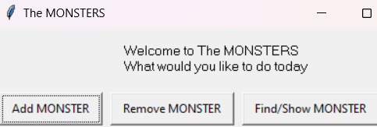
[Remove Monster Cards]: Testing
You must show the results of testing. For each component, include a screenshot proving it works. You can also include notes about each test.
Test Cases - input | Expected output
What Would you like to do today [Welcome] -Remove MONSTERS | Show first monsters details
Previous | Go to the previous monster
Next | Go to the next monster
Delete -Delete every monster | Delete current card There are no monsters in this catalogue
Exit | Return to welcome function
Z
Z
Z
Notes:
You must show the results of testing. For each component, include a screenshot proving it works. You can also include notes about each test.

Slide 16
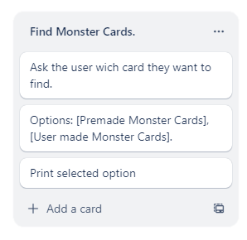
[Find Monster Cards] (Trello screenshot)

Slide 17
[Find Monster Cards] - Test Plan
Additional rows can be added by clicking in the last cell and then using the Tab key
Test Cases - input | Expected output
What Monster Card would you like to Find | Show Options
Premade cards | Print MONSTERS stats
User made cards | Print MONSTERS stats
Exit | Return to welcome function
Notes:
Additional rows can be added by clicking in the last cell and then using the Tab key

Slide 18
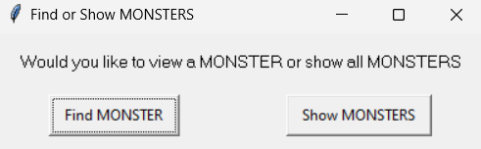
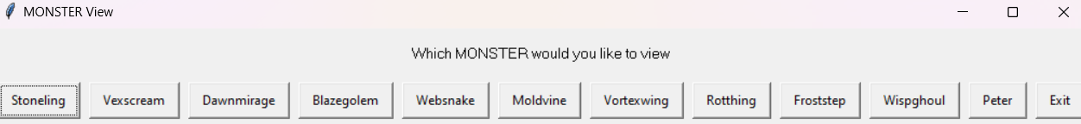
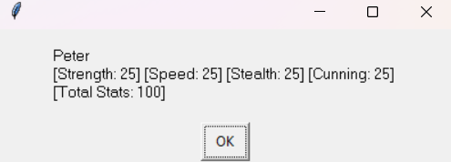
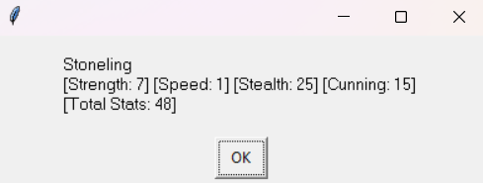
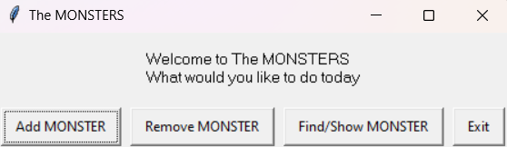
[Find Monster Cards]: Testing
Test Cases - input | Expected output
Would you like to view a MONSTER or Show all MONSTERS -Find MONSTERS | Proceed to show monsters Show Options
What Monster Card would you like to view -Premade card -User made card | Show details of selected monster
Exit | Return to welcome function
Notes:
You must show the results of testing. For each component, include a screenshot proving it works. You can also include notes about each test.

Slide 19
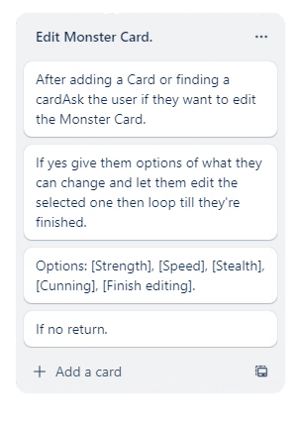
[Edit Monster Card] (Trello screenshot)

Slide 20
[Edit Monster Cards] - Test Plan
Additional rows can be added by clicking in the last cell and then using the Tab key
Test Cases - input | Expected output
What Monster trait would you like to edit | Show Options
Strength | Edit selected trait
Speed | Edit selected trait
Stealth | Edit selected trait
Cunning | Edit selected trait
Return | Return to welcome function
Notes:
Additional rows can be added by clicking in the last cell and then using the Tab key

Slide 21
[Edit Monster Cards]: Testing
You must show the results of testing. For each component, include a screenshot proving it works. You can also include notes about each test.
Notes:
You must show the results of testing. For each component, include a screenshot proving it works. You can also include notes about each test.

Slide 22
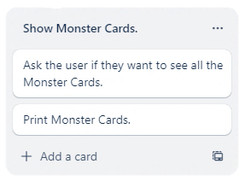
[Show Monster Cards] (Trello screenshot)

Slide 23
[Show Monster Cards] - Test Plan
Additional rows can be added by clicking in the last cell and then using the Tab key
Test Cases – input | Expected output
Would you like to View a MONSTER or Show all MONSTERS -Show MONTERS | Procced to Show Monsters
Previous | Go to the previous monster
Next | Go to the next monster
Exit | Return to welcome
Notes:
Additional rows can be added by clicking in the last cell and then using the Tab key

Slide 24
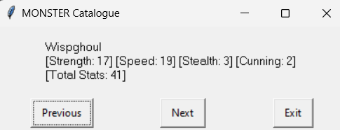
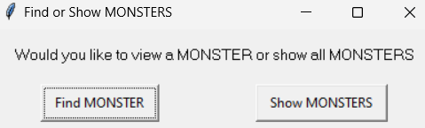
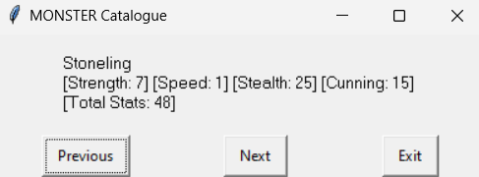
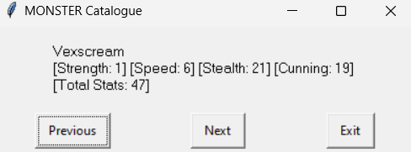
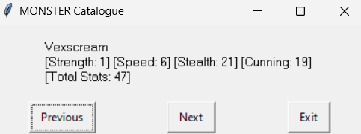
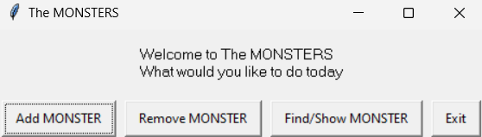
[Show Monster Cards]: Testing
You must show the results of testing. For each component, include a screenshot proving it works. You can also include notes about each test.
Test Cases – input | Expected output
Would you like to View a MONSTER or Show all MONSTERS -Show MONTERS | Procced to Show Monsters
Previous | Go to the previous monster
Next | Go to the next monster
Exit | Return to welcome
Notes:
You must show the results of testing. For each component, include a screenshot proving it works. You can also include notes about each test.

Slide 25
[]: Trialling
NOTE: Trialling needs to happen for at least 2 of your components but is not necessary for ALL components.
Trialling is not the same as testing. Trialling is about finding different ways of building the same component. Show evidence of your trialling here. Select one of your trials for further development and give reasons for your choice.
Notes:
NOTE: Trialling needs to happen for at least 2 of your components but is not necessary for ALL components.
Trialling is not the same as testing. Trialling is about finding different ways of building the same component. Show evidence of your trialling here. Select one of your trials for further development and give reasons for your choice.

Slide 26
Assembled Outcome Testing:
Show testing for your assembled outcome below. This should include a test plan followed by screenshot proof.
Notes:
Show testing for your assembled outcome below. This should include a test plan followed by screenshot proof.

Slide 27
Address relevant Implications:
Relevant implication | Explain how your final outcome addresses each implication
Usability
Functionality
Future proofing
Aesthetics

Slide 28
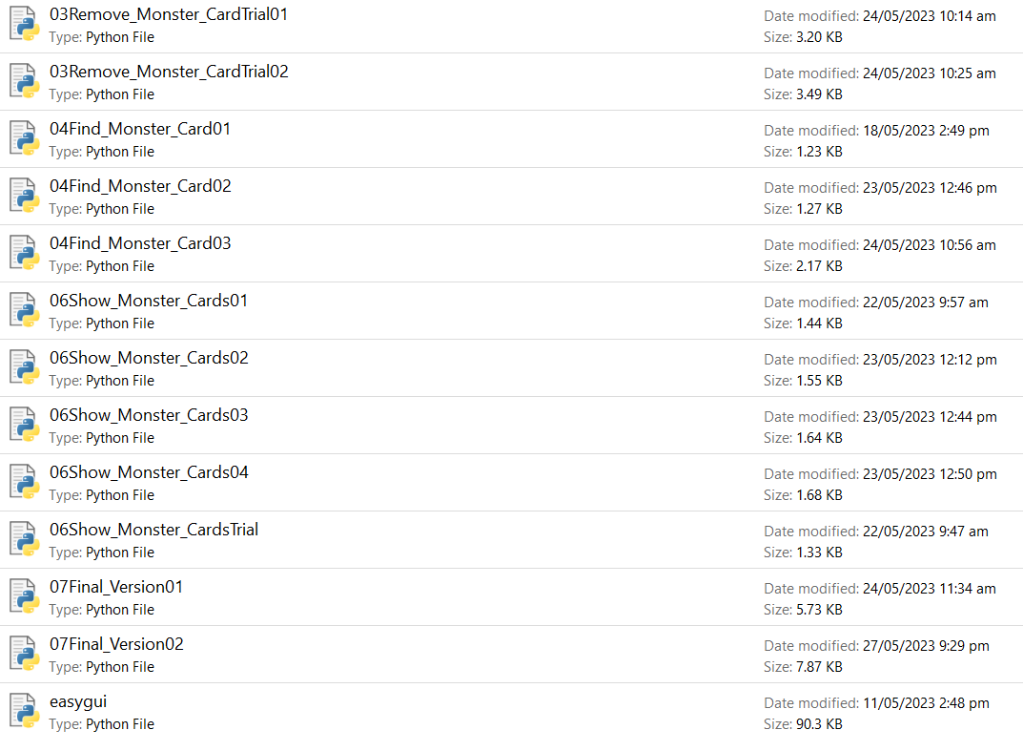
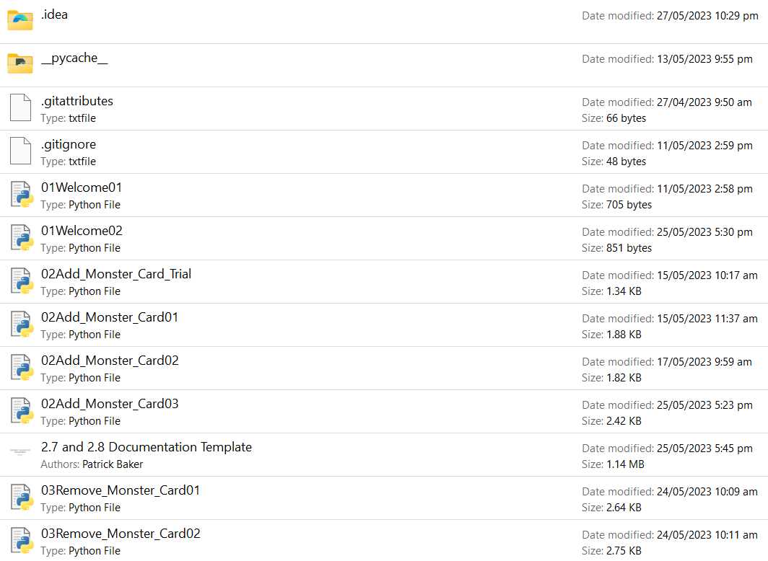
Version Control Evidence:
Notes:
Your version control evidence should go here. This could be in the form of screenshots (both of your GitHub repository as well as your local project folder) as evidence of your incremental development.

Slide 29
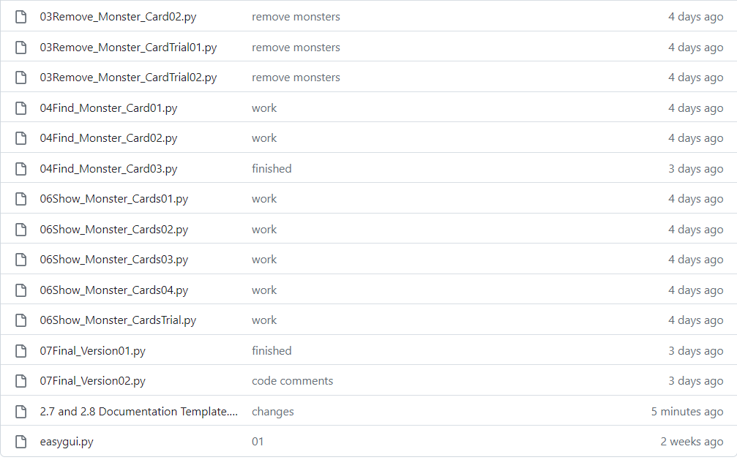
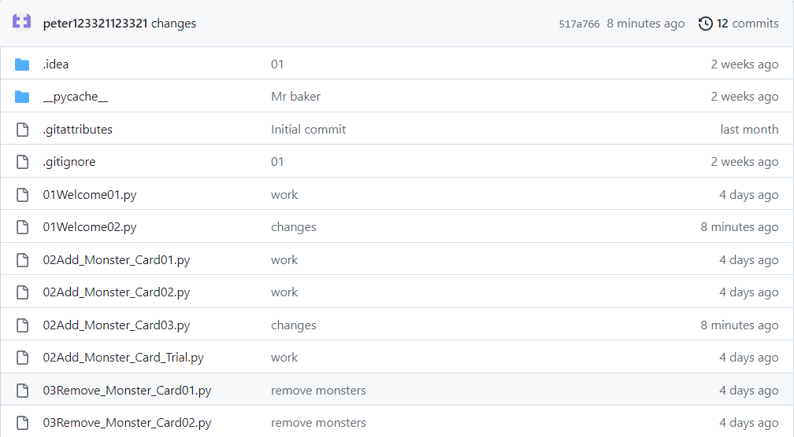
Version Control Evidence:
Notes:
Your version control evidence should go here. This could be in the form of screenshots (both of your GitHub repository as well as your local project folder) as evidence of your incremental development.

Slide 30
Final Discussion:
Discuss how the information from planning, testing and trialling of components assisted in the development of a high-quality outcome.
Notes:
Discuss how the information from planning, testing and trialling of components assisted in the development of a high-quality outcome.

